Slide 1
Life Clinic
Digitalized prescription application

Slide 2
Key numbers
25%
22.2%
Experts say that up to 25 percent of medication errors may be related to illegible handwriting
Overall, E-prescriptions were significantly associated with a reduced error rate (67.7% vs45.5%, p<0.0001)

Slide 3
Life clinic
Life clinic is an app that makes your prescription digital to prevent the mistakes that happens when you or the pharmacist read the prescription wrong

Slide 4
Mission and vision
Mission
Vision
Clinic system that manages and makes the doctor add prescription for the patient
Making prescriptions digital to make the patient safe as possible by preventing any mistake that may occur during reading handwritten prescription

Slide 5
Our app
What makes our app special?
clear and easy to use
All digital so you take your right medications
Safe to use , you wont have to worry about your personal data
And the most important thing:the patients safety is our number one priority .

Slide 6
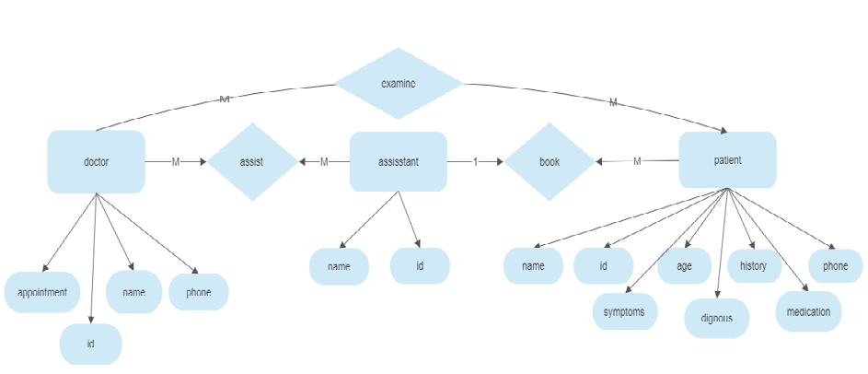

Slide 7

Thank you
Presented by
Habiba Ahmed
Rwida Gaber
Camellia Mohamed
Under the supervising of :
Dr. Amany Salama

